Slide 1
WorldBank/Bedrock in Collaboration with CodeAnt Training 2024/2025: Week 11/12 Assessment on Power BI
Showing report of Nigeria Health Data Analysis for year of 2009 to 2018
Done and Presented by: Ekpendu Franca

Slide 2
TABLE OF CONTENTS
Project Schedule: About the project
Business/Meeting Objectives
Project timeline
Analysis and Dashboards
Conclusion/Recommendation
Ask me any question
Done and Presented by: Ekpendu Franca

Slide 3
Project Schedule: About the Project
The project “Nigeria Health Dataset” covers some diseases that affects both young and old citizens of Nigeria. The project covers the timeframe of ten(10)years starting from 2009 to 2018 with cases of confirmed dead and not confirmed in 36 states of federation.
Done and Presented by: Ekpendu Franca

Slide 4
Business/Meeting Objectives
The objectives that I adopted on assessment include:
Which states has the highest incidence of Malaria and Cholera?
Which State has the highest death rate due to Cholera?
Which group do we have the highest disease occurrence, rural or urban?
Which diseases has the highest death rate in 2010 and 2018?
Which year do we have highest incidence of Meningitis?
Which Age group are more perceptible to Diarrhoea?
Done and Presented by: Ekpendu Franca

Slide 5
Project Timeline
It only took roughly two weeks to cover this assessment which Start from 6th of February, 2025
Done and Presented by: Ekpendu Franca

Slide 6
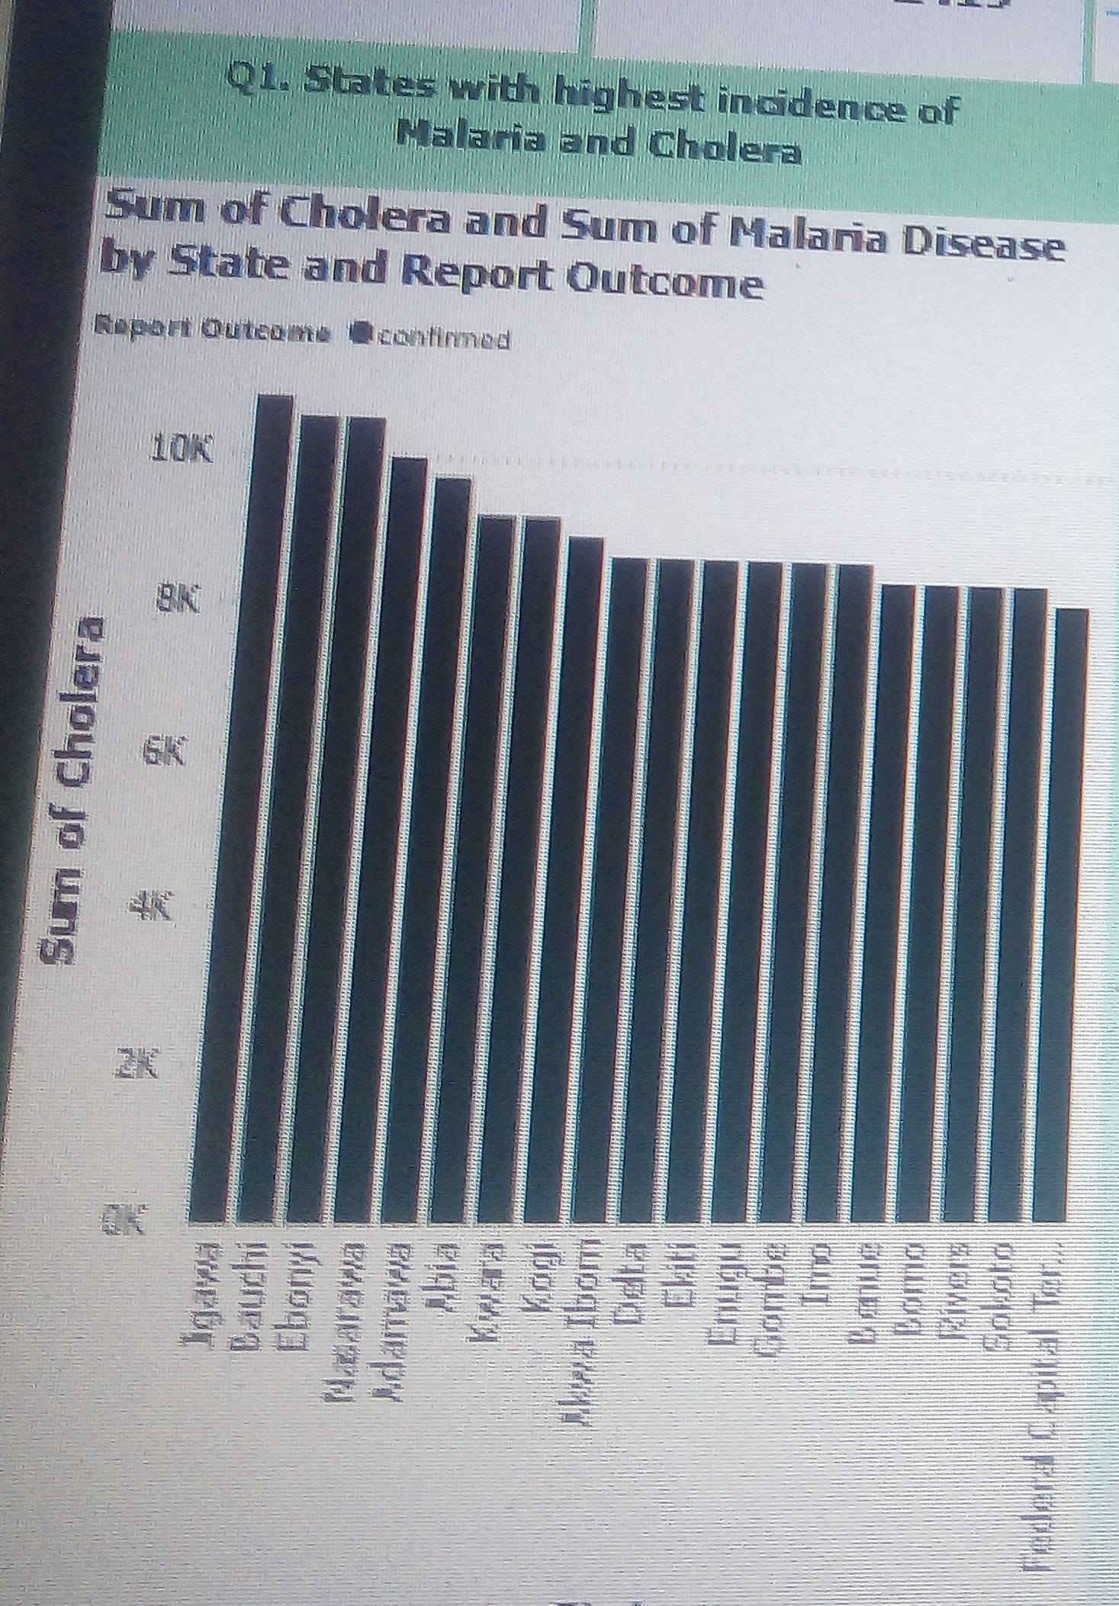
Analysis and Dashboards
Which states has the highest incidence of Malaria and Cholera?
The analysis shows that Jigawa has the highest confirmed incidence of Malaria with sum 9198 and Cholera with sum of 10752 followed by Bauchi and Ebonyi that has a total number of 8979 for malaria and 10496 for cholera.
Section 1:
Done and Presented by: Ekpendu Franca

Slide 7
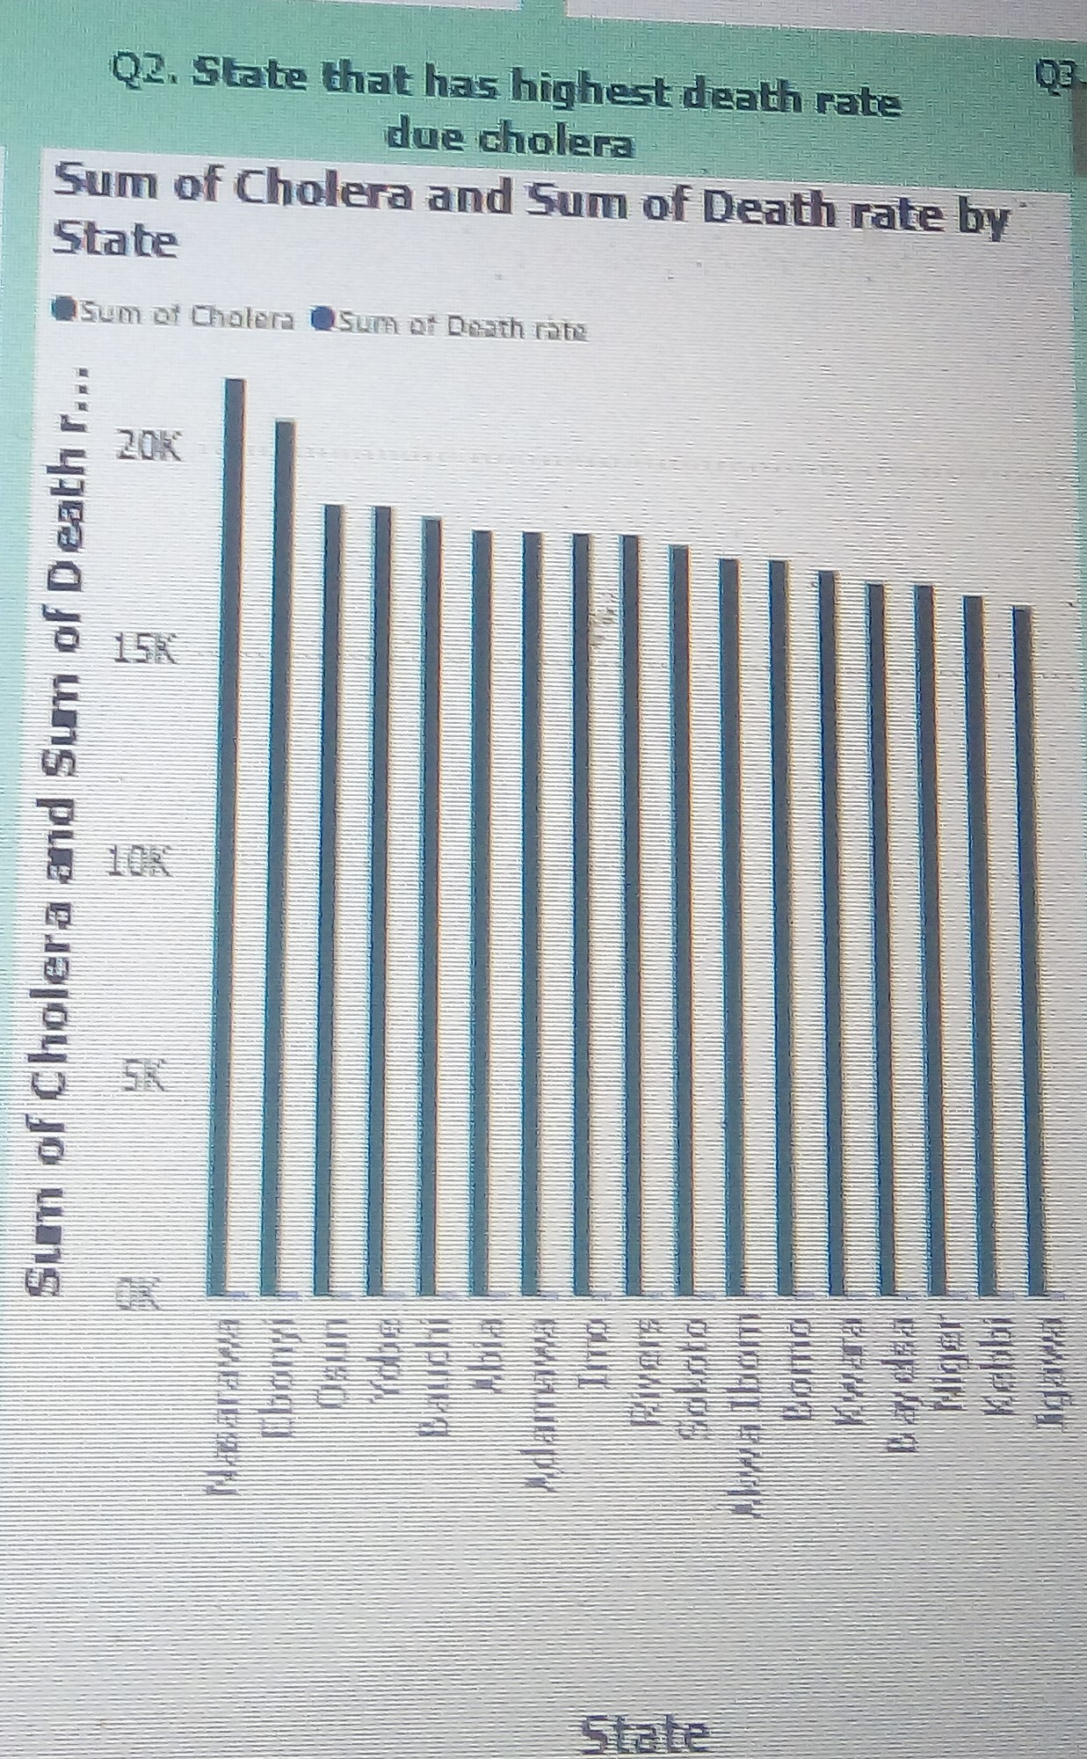
Analysis and Dashboards
Section 2:
Which State has the highest death rate due to Cholera?
Result shows that Nasarawa state has the highest death rate due to Cholera with total number 21760 patients.
Done and Presented by: Ekpendu Franca

Slide 8
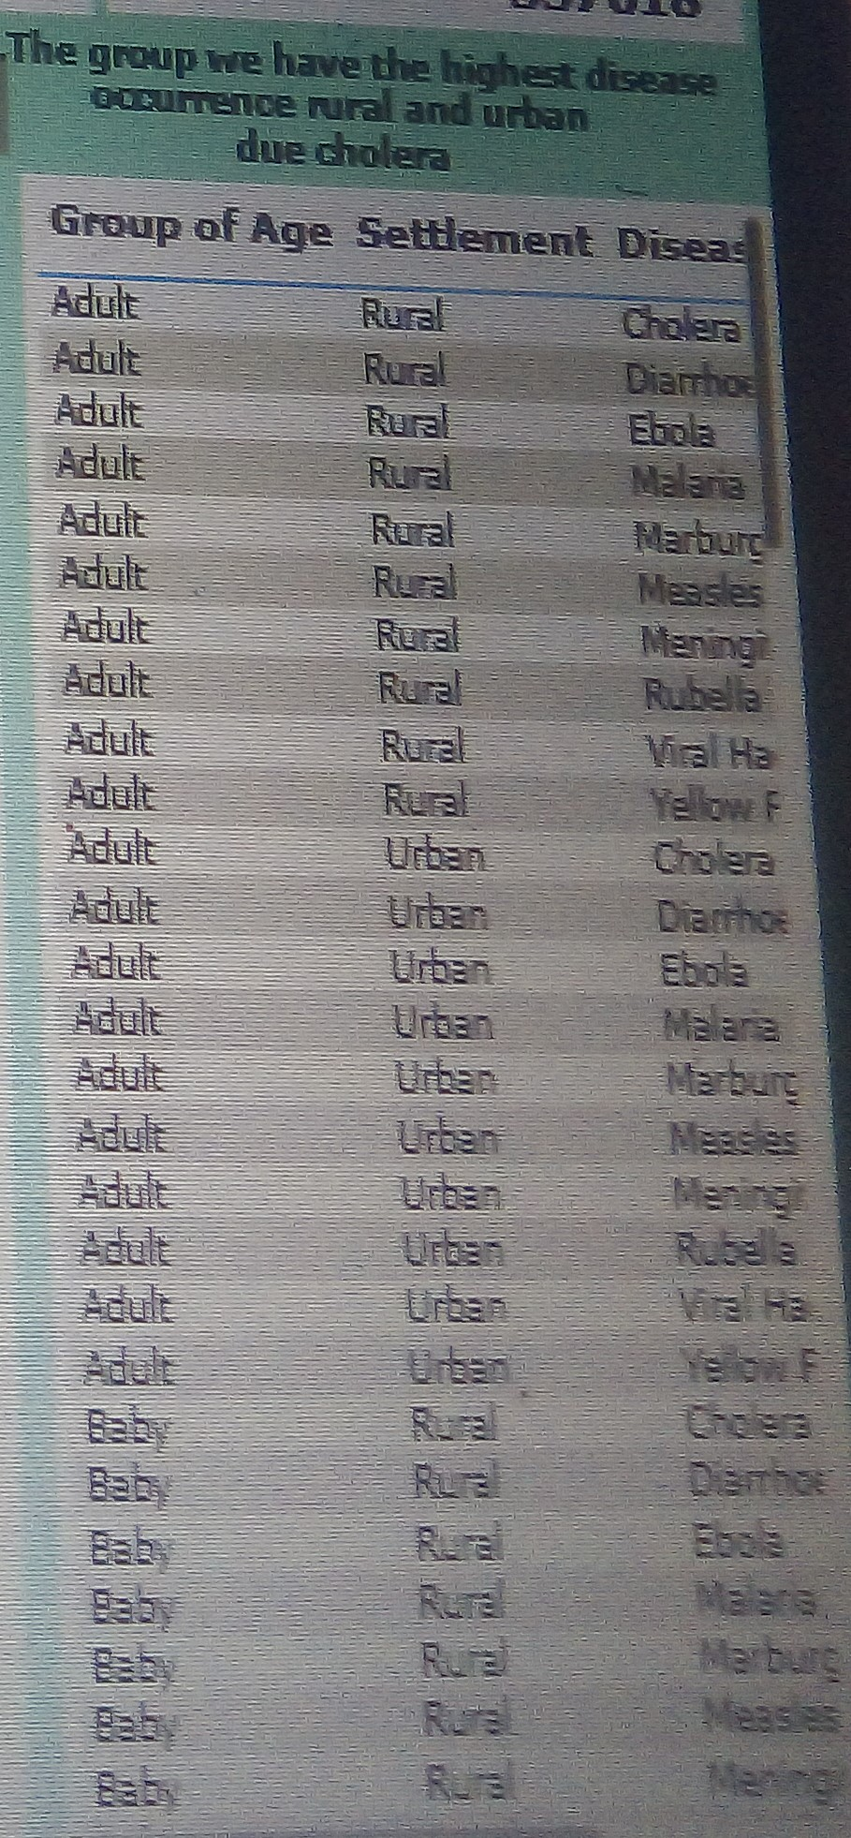
Analysis and Dashboards
Which group do we have the highest disease occurrence, rural or urban?
Result shows that Adults, Young Adults and Teenagers has the highest diseases occurrence both in rural and urban areas.
Section 3:
Done and Presented by: Ekpendu Franca

Slide 9
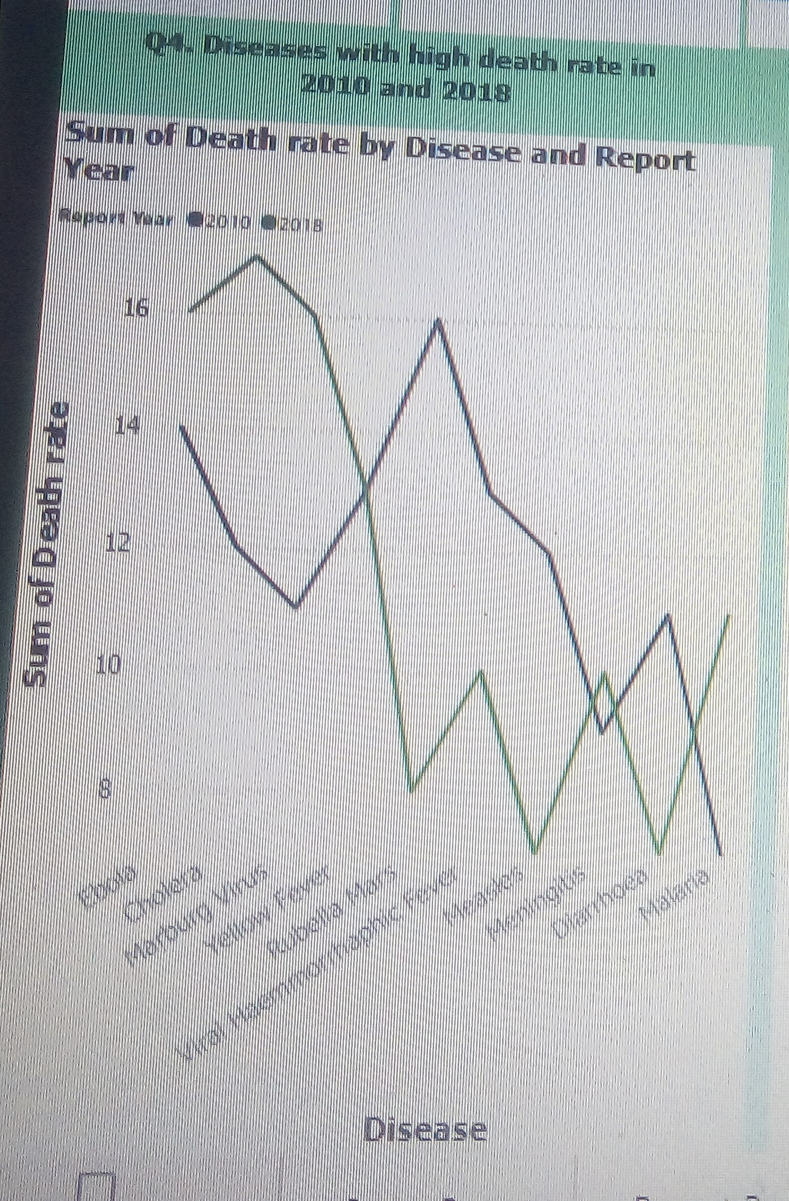
Analysis and Dashboards
Which diseases has the highest death rate in 2010 and 2018?
The analysis shows that Cholera and Ebola has the highest death rate in 2018 while Rubella Mars, Yellow fever and viral haemmorrhaphic has the highest death rate in 2010
Section 4:
Done and Presented by: Ekpendu Franca

Slide 10
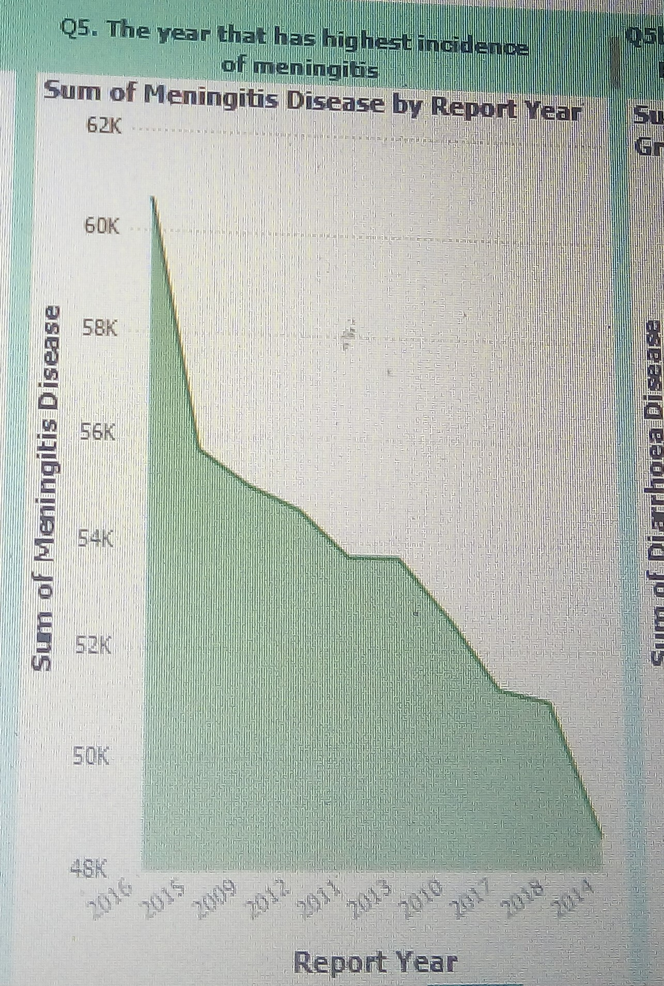
Analysis and Dashboards
Which year do we have highest incidence of Meningitis?
Result shows that 2016 has the highest incidence of Meningitis with a total of number of 60608 patients.
Section 5:
Done and Presented by: Ekpendu Franca

Slide 11
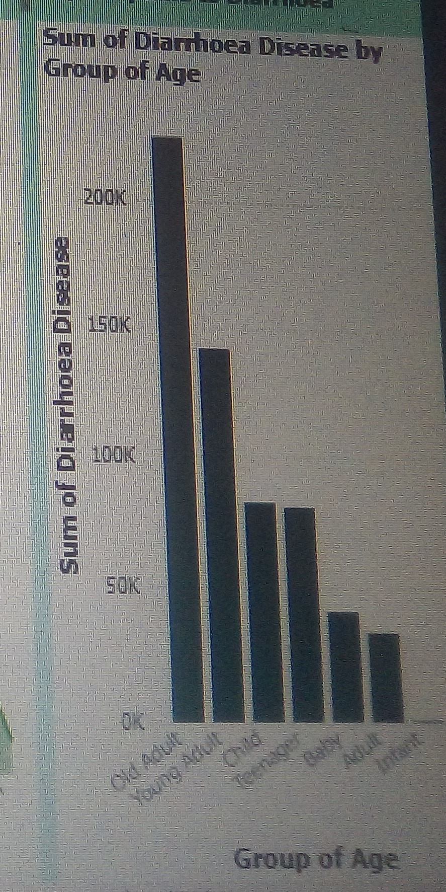
Analysis and Dashboards
Which Age group are more perceptible to Diarrhoea?
Result shows that old Adults are more perceptible to Diarrhoea with total of number of 225500.
Section 6:
Done and Presented by: Ekpendu Franca

Slide 12
Conclusion/Recommendations
Conclusion:
Based on the analytical skills, I observed that diseases has affected Nigerian in a large number to extent that a large of number of people/Nigerian citizens suffer from them and some has lose their lives.
Recommendations:
I recommend that Nigeria government should take health issues of her citizens very serious by providing vaccines, immunizations, drugs, hospitals and medical care and also create awareness across the federation, enlighten people on how to avoid and treat the diseases that affect them.
Done and Presented by: Ekpendu Franca

Slide 13
THANK YOU ASK ME ANY QUESTION
Done and Presented by: Ekpendu Franca

